Slide 1
THE ECOLOGICAL PROBLEMS
OF MOSCOW REGION
Free Powerpoint Templates

Slide 2
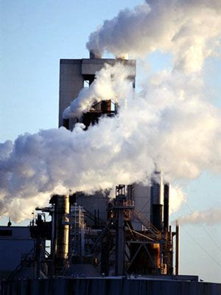
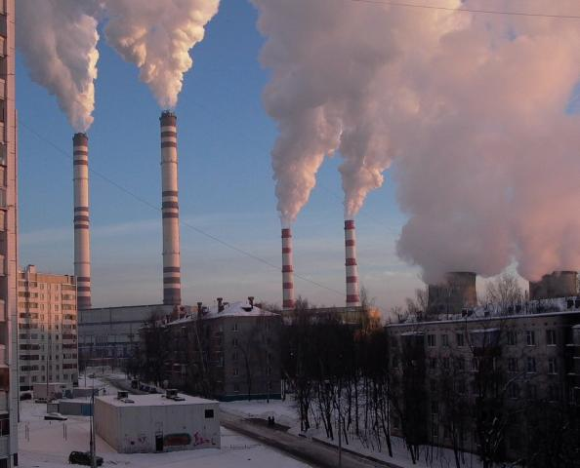
The Ecological Situation is dangerous in Moscow Region because of air and water pollution

Slide 3
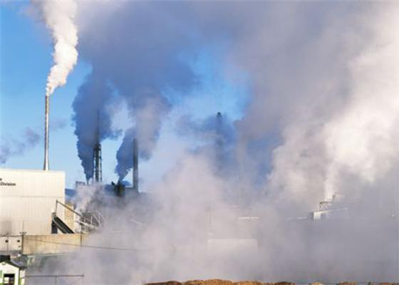
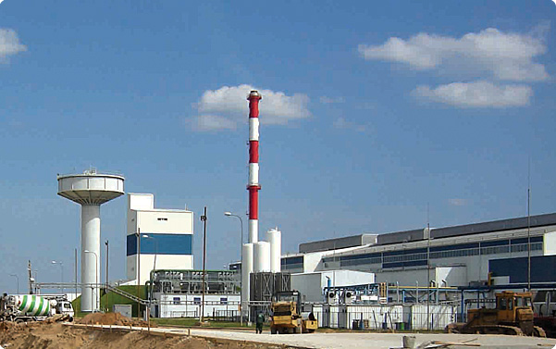
The Most Polluted Towns in Moscow Region
Voskresensk
Klin

Slide 4
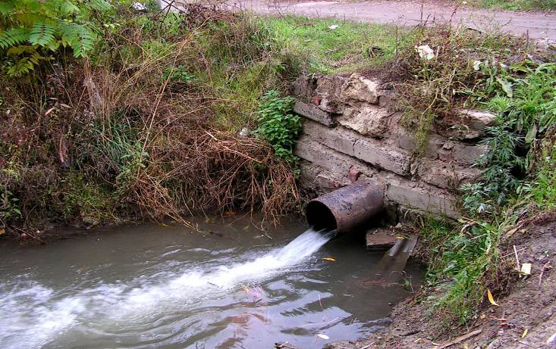
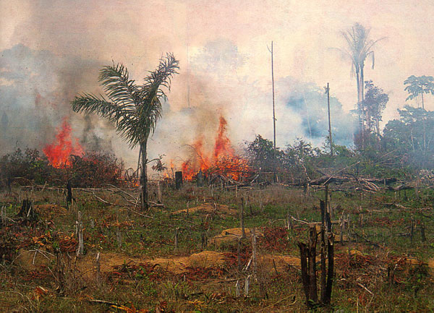
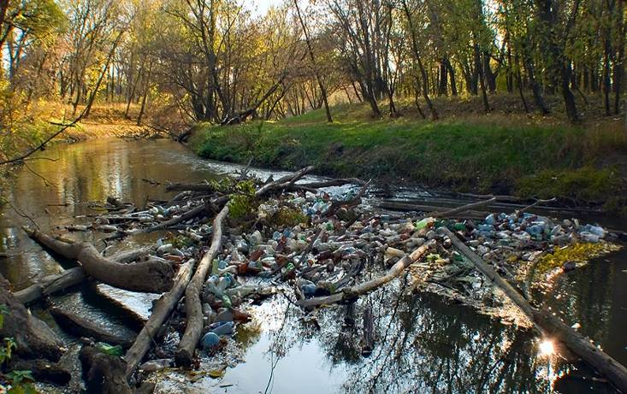
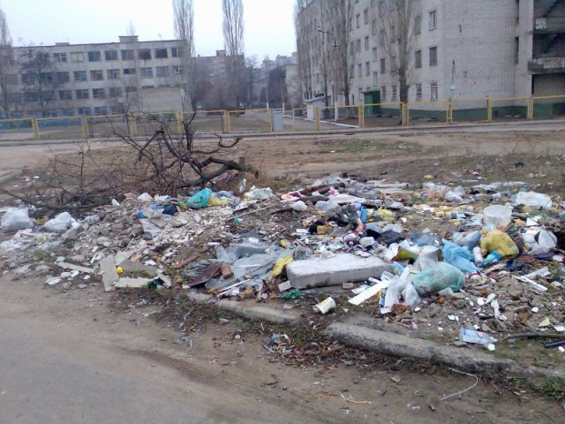
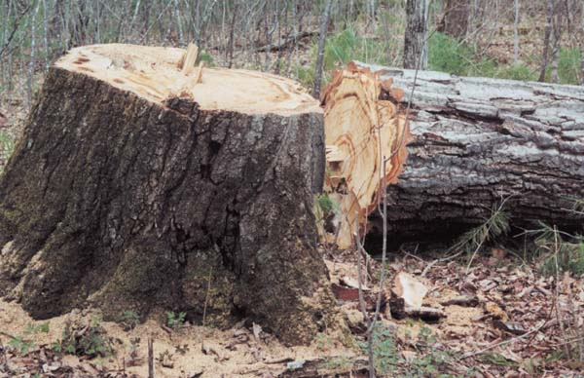
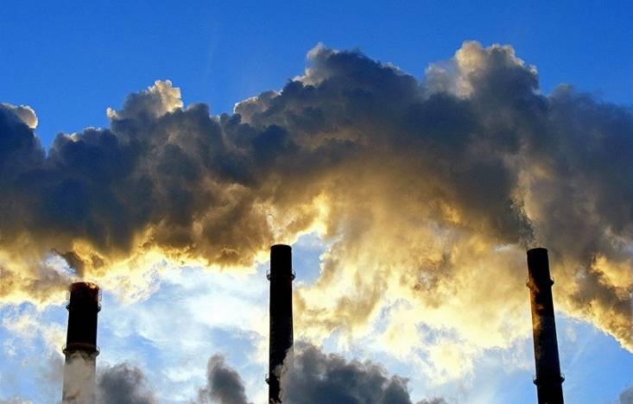
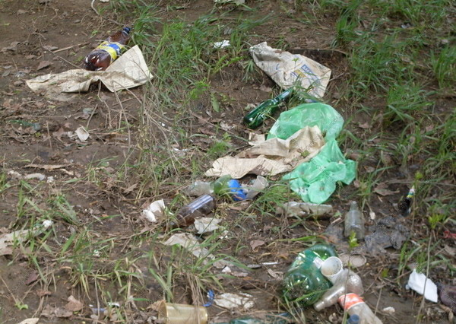
But what are we doing? Just look!

Slide 5
The Air is polluted in:
Voskresensk with ammonia
Klin, Kolomna, Podolsk with formaldehyde
Serpuhov with phenol

Slide 6
In big towns cars are the biggest air polluters too

Slide 7
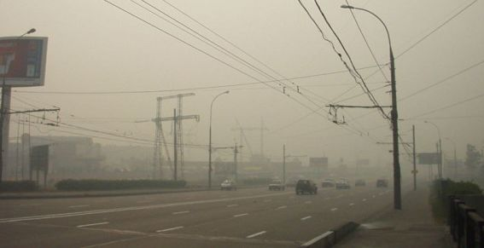
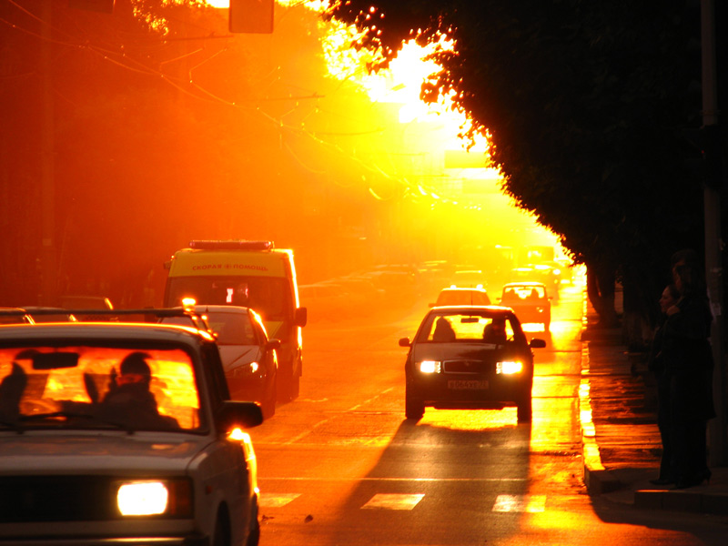
We could hardly breath in 2010 as the air was filled with smoke

Slide 8
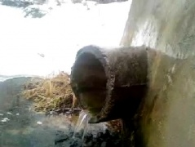
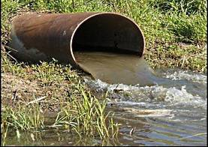
Water Pollution
The rivers of Moscow Region are filled with poison: industrial waste, chemicals and pesticides

Slide 9
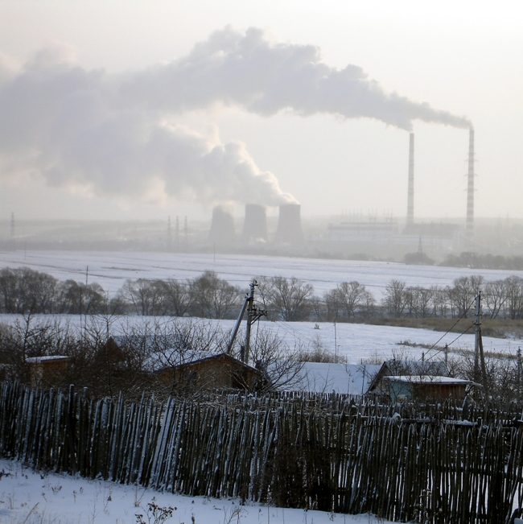
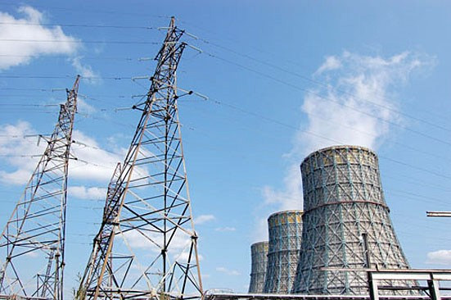
The Kashira Hydroelectric Power Plant

Slide 10
The Shatura Hydroelectric Power Plant

Slide 11
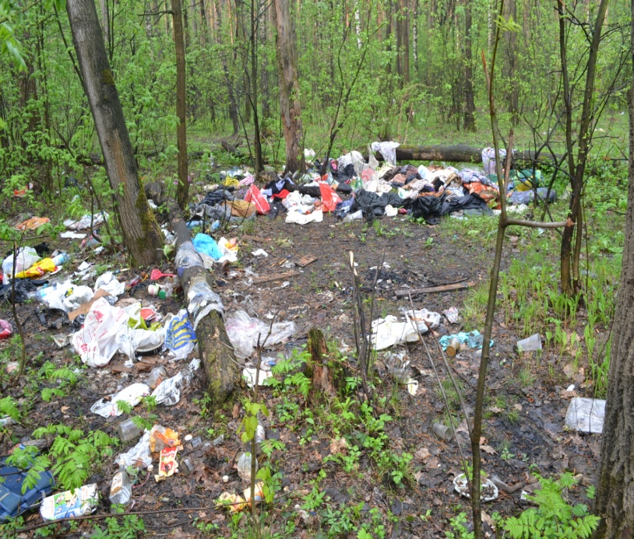
8 million tons of waste is thrown into the dumps of Moscow Region every year

Slide 12
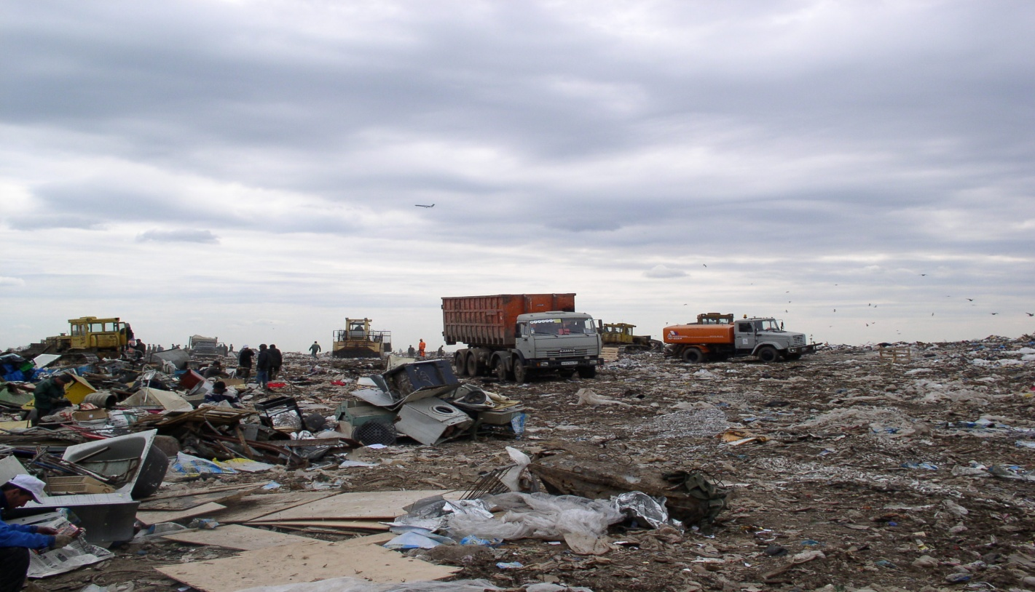
The Largest Dumps in Moscow Region
Salarievo (Leninskiy Region) is the biggest rubbish dump in Europe

Slide 13
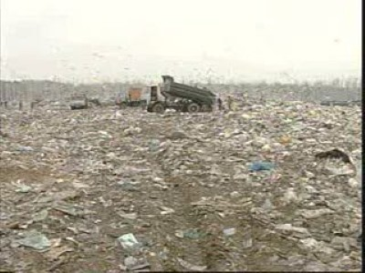
Timohovo (Noginsk)

Slide 14
Ecology influences human’s health
Pollution (air, water, radiation) causes dangerous diseases of the most internal organs:
Lungs,
Heart,
Liver,
Stomach,
Blood circulation,
Nervous system

Slide 15
Let's save our future generation!!!

Slide 16
SAVE OUR PLANET!
Free Powerpoint Templates

Slide 17
Look how beautiful our planet can be!

